Slide 1
GUI using SWING Event Handling
Java Swing tutorial is a part of Java Foundation Classes (JFC) that is used to create window-based applications. It is built on the top of AWT (Abstract Windowing Toolkit) API and entirely written in java.
Swing is a GUI widget toolkit for Java. It is part of Oracle's Java Foundation Classes – an API for providing a graphical user interface for Java programs. Swing was developed to provide a more sophisticated set of GUI components than the earlier Abstract Window Toolkit.
Unlike AWT, Java Swing provides platform-independent and lightweight components.
The javax.swing package provides classes for java swing API such as JButton, JTextField, JTextArea, JRadioButton, JCheckbox, JMenu, JColorChooser etc.

Slide 2
Difference between AWT and Swing
No. | Java AWT | Java Swing
1) | AWT components are platform-dependent. | Java swing components are platform-independent.
2) | AWT components are heavyweight. | Swing components are lightweight.
3) | Java AWT is an API to develop GUI applications in Java | Swing is a part of Java Foundation Classes and is used to create various applications.
4) | AWT provides less components than Swing. | Swing provides more powerful components such as tables, lists, scrollpanes, colorchooser, tabbedpane etc.
5) | AWT doesn't follows MVC(Model View Controller) where model represents data, view represents presentation and controller acts as an interface between model and view. | Swing follows MVC.
6) | Java AWT has comparatively less functionality as compared to Swing. | Java Swing has more functionality as compared to AWT.
7) | The execution time of AWT is more than Swing. | The execution time of Swing is less than AWT.

Slide 3
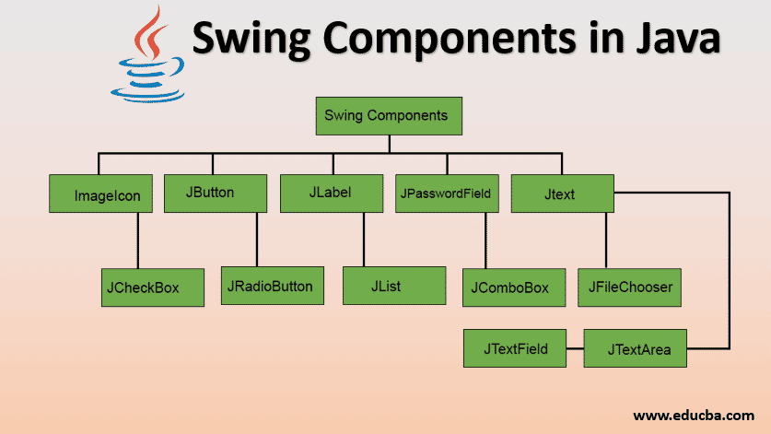
Swing Components

Slide 4
1. JFrame
The javax.swing.JFrame class is a type of container which inherits the java.awt.Frame class. JFrame works like the main window where components like labels, buttons, textfields are added to create a GUI.
Unlike Frame, JFrame has the option to hide or close the window with the help of setDefaultCloseOperation(int) method.
Nested Classes
Modifier and Type | Class | Description
protected class | JFrame.AccessibleJFrame | This class implements accessibility support for the JFrame class.

Slide 5
Fields
Modifier and Type | Field | Description
protected AccessibleContext | accessibleContext | The accessible context property.
static int | EXIT_ON_CLOSE | The exit application default window close operation.
protected JRootPane | rootPane | The JRootPane instance that manages the contentPane and optional menuBar for this frame, as well as the glassPane.
protected boolean | rootPaneCheckingEnabled | If true then calls to add and setLayout will be forwarded to the contentPane.

Slide 6
Constructors
Constructor | Description
JFrame() | It constructs a new frame that is initially invisible.
JFrame(GraphicsConfiguration gc) | It creates a Frame in the specified GraphicsConfiguration of a screen device and a blank title.
JFrame(String title) | It creates a new, initially invisible Frame with the specified title.
JFrame(String title, GraphicsConfiguration gc) | It creates a JFrame with the specified title and the specified GraphicsConfiguration of a screen device.

Slide 7
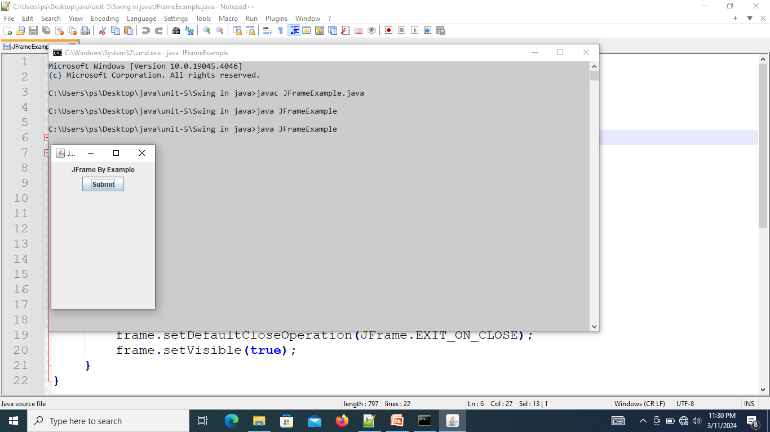
import java.awt.FlowLayout;
import javax.swing.JButton;
import javax.swing.JFrame;
import javax.swing.JLabel;
import javax.swing.JPanel;
public class JFrameExample {
public static void main(String args[]) {
JFrame frame = new JFrame("JFrame Example");
JPanel panel = new JPanel();
panel.setLayout(new FlowLayout());
JLabel label = new JLabel("JFrame By Example");
JButton button = new JButton();
button.setText("Submit");
panel.add(label);
panel.add(button);
frame.add(panel);
frame.setSize(200, 300);
// frame.setLocationRelativeTo(null);
frame.setDefaultCloseOperation(JFrame.EXIT_ON_CLOSE);
frame.setVisible(true);
}
}

Slide 8
JPanel
The JPanel is a simplest container class. It provides space in which an application can attach any other component. It inherits the JComponents class.
It doesn't have title bar.
JPanel class declaration
public class JPanel extends JComponent implements Accessible

Slide 9
Commonly used Constructors
Constructor | Description
JPanel() | It is used to create a new JPanel with a double buffer and a flow layout.
JPanel(boolean isDoubleBuffered) | It is used to create a new JPanel with FlowLayout and the specified buffering strategy.
JPanel(LayoutManager layout) | It is used to create a new JPanel with the specified layout manager.

Slide 10
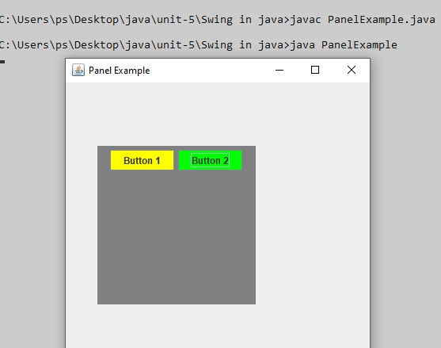
f.setSize(400,400);
f.setLayout(null);
f.setVisible(true);
}
public static void main(String args[])
{
new PanelExample();
}
}
import java.awt.*;
import javax.swing.*;
public class PanelExample {
PanelExample()
{
JFrame f= new JFrame("Panel Example");
JPanel panel=new JPanel();
panel.setBounds(40,80,200,200);
panel.setBackground(Color.gray);
JButton b1=new JButton("Button 1");
b1.setBounds(50,100,80,30);
b1.setBackground(Color.yellow);
JButton b2=new JButton("Button 2");
b2.setBounds(100,100,80,30);
b2.setBackground(Color.green);
panel.add(b1); panel.add(b2);
f.add(panel);

Slide 11
JLabel
JLabel is a class of java Swing . JLabel is used to display a short string or an image icon. JLabel can display text, image or both .
JLabel is only a display of text or image and it cannot get focus .
JLabel is inactive to input events such a mouse focus or keyboard focus.
By default labels are vertically centered but the user can change the alignment of label.

Slide 12
Constructor of the class are :
JLabel() : creates a blank label with no text or image in it.
JLabel(String s) : creates a new label with the string specified.
JLabel(Icon i) : creates a new label with a image on it.
JLabel(String s, Icon i, int align) : creates a new label with a string, an image and a specified horizontal alignment
Methods of JLabel
getIcon() : returns the image that the label displays
setIcon(Icon i) : sets the icon that the label will display to image i
getText() : returns the text that the label will display
setText(String s) : sets the text that the label will display to string s

Slide 13
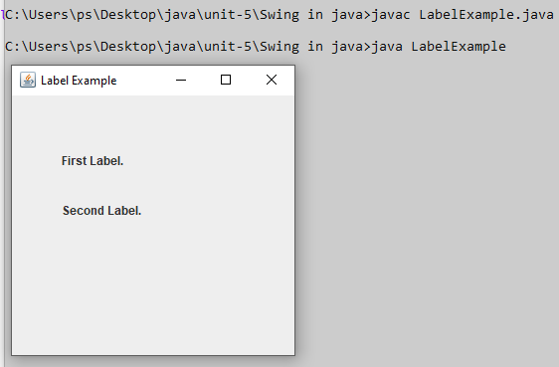
import javax.swing.*;
class LabelExample
{
public static void main(String args[])
{
JFrame f= new JFrame("Label Example");
JLabel l1,l2;
l1=new JLabel("First Label.");
l1.setBounds(50,50, 100,30);
l2=new JLabel("Second Label.");
l2.setBounds(50,100, 100,30);
f.add(l1); f.add(l2);
f.setSize(300,300);
f.setLayout(null);
f.setVisible(true);
}
}

Slide 14
JButton
The JButton class is used to create a labeled button that has platform independent implementation. The application result in some action when the button is pushed. It inherits AbstractButton class.
AbstractButton is an abstract base class for all button components ( JButton , JToggleButton , JCheckBox , JRadioButton , and JMenuItem and its subclasses). Since it provides functionality common to all types of buttons.
JButton class declaration :
public class JButton extends AbstractButton implements Accessible

Slide 15
Constructor | Description
JButton() | It creates a button with no text and icon.
JButton(String s) | It creates a button with the specified text.
JButton(Icon i) | It creates a button with the specified icon object.

Slide 16
Methods | Description
void setText(String s) | It is used to set specified text on button
String getText() | It is used to return the text of the button.
void setEnabled(boolean b) | It is used to enable or disable the button.
void setIcon(Icon b) | It is used to set the specified Icon on the button.
Icon getIcon() | It is used to get the Icon of the button.
Void addActionListener(ActionListener a) | It is used to add the action listener to this object.

Slide 17
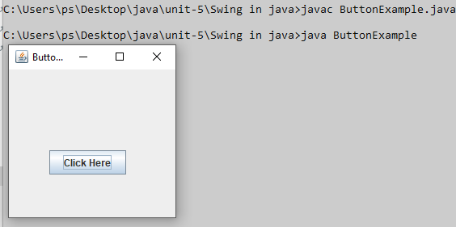
import javax.swing.*;
public class ButtonExample {
public static void main(String[] args) {
JFrame f=new JFrame("Button Example");
JButton b=new JButton("Click Here");
b.setBounds(50,100,95,30);
f.add(b);
f.setSize(400,400);
f.setLayout(null);
f.setVisible(true);
}
}

Slide 18
JRadioButton
The JRadioButton class is used to create a radio button. It is used to choose one option from multiple options. It is widely used in exam systems or quiz.
It should be added in ButtonGroup to select one radio button only.
JRadioButton class declaration :
public class JRadioButton extends JToggleButton implements Accessible

Slide 19
Constructor | Description
JRadioButton() | Creates an unselected radio button with no text.
JRadioButton(String s) | Creates an unselected radio button with specified text.
JRadioButton(String s, boolean selected) | Creates a radio button with the specified text and selected status.

Slide 20
Methods | Description
void setText(String s) | It is used to set specified text on button.
String getText() | It is used to return the text of the button.
void setEnabled(boolean b) | It is used to enable or disable the button.
void setIcon(Icon b) | It is used to set the specified Icon on the button.
Icon getIcon() | It is used to get the Icon of the button.
void setMnemonic(int a) | It is used to set the mnemonic on the button.
void addActionListener(ActionListener a) | It is used to add the action listener to this object.

Slide 21
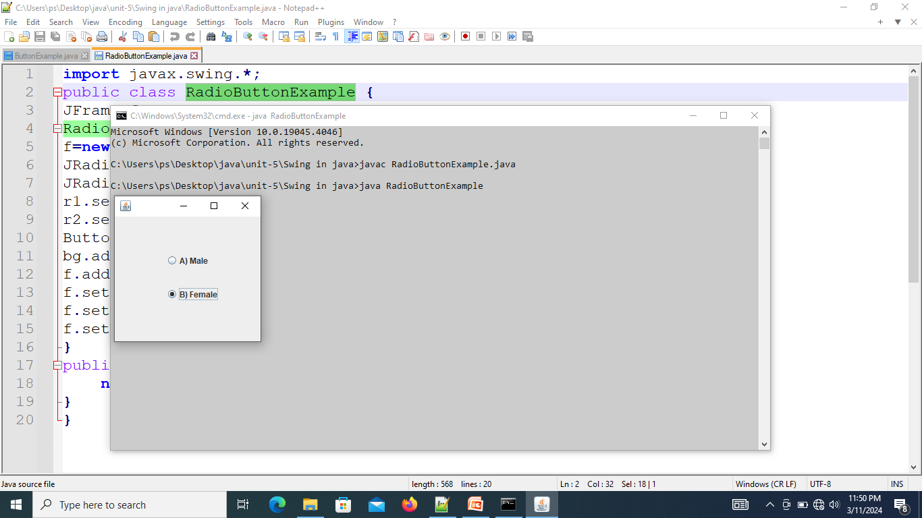
import javax.swing.*;
public class RadioButtonExample {
JFrame f;
RadioButtonExample(){
f=new JFrame();
JRadioButton r1=new JRadioButton("A) Male");
JRadioButton r2=new JRadioButton("B) Female");
r1.setBounds(75,50,100,30);
r2.setBounds(75,100,100,30);
ButtonGroup bg=new ButtonGroup();
bg.add(r1);bg.add(r2);
f.add(r1);f.add(r2);
f.setSize(300,300);
f.setLayout(null);
f.setVisible(true);
}
public static void main(String[] args) {
new RadioButtonExample();
}
}

Slide 22
JCheckBox
The JCheckBox class is used to create a checkbox. It is used to turn an option on (true) or off (false). Clicking on a CheckBox changes its state from "on" to "off" or from "off" to "on ".It inherits JToggleButton class.
JCheckBox class declaration
public class JCheckBox extends JToggleButton implements Accessible

Slide 23
Constructor of the class are :
JCheckBox() : creates a new checkbox with no text or icon
JCheckBox(Icon i) : creates a new checkbox with the icon specified
JCheckBox(Icon icon, boolean s) : creates a new checkbox with the icon specified and the boolean value specifies whether it is selected or not.
JCheckBox(String t) :creates a new checkbox with the string specified
JCheckBox(String text, boolean selected) :creates a new checkbox with the string specified and the boolean value specifies whether it is selected or not.
JCheckBox(String text, Icon icon) :creates a new checkbox with the string and the icon specified.
JCheckBox(String text, Icon icon, boolean selected): creates a new checkbox with the string and the icon specified and the boolean value specifies whether it is selected or not.

Slide 24
Commonly used methods:
setIcon(Icon i) : sets the icon of the checkbox to the given icon
setText(String s) :sets the text of the checkbox to the given text
setSelected(boolean b) : sets the checkbox to selected if boolean value passed is true or vice versa
getIcon() : returns the image of the checkbox
getText() : returns the text of the checkbox

Slide 25
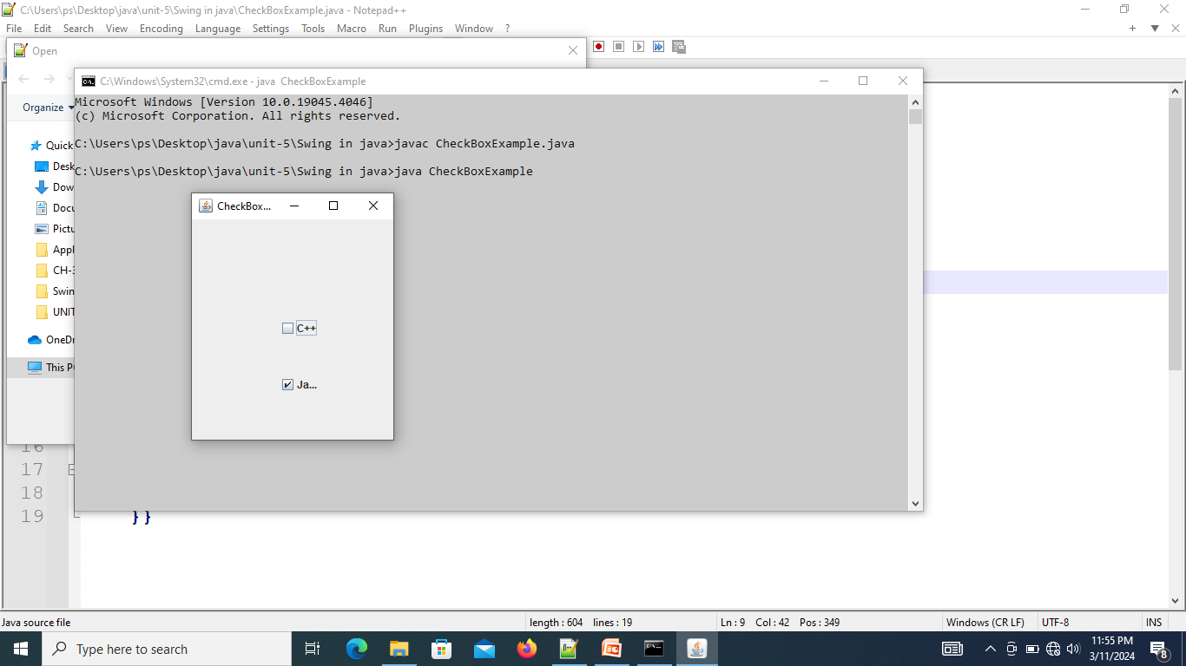
import javax.swing.*;
public class CheckBoxExample
{
CheckBoxExample(){
JFrame f= new JFrame("CheckBox Example");
JCheckBox checkBox1 = new JCheckBox("C++");
checkBox1.setBounds(100,100, 50,50);
JCheckBox checkBox2 = new JCheckBox("Java", true);
checkBox2.setBounds(100,150, 50,80);
f.add(checkBox1);
f.add(checkBox2);
f.setSize(400,400);
f.setLayout(null);
f.setVisible(true);
}
public static void main(String args[])
{
new CheckBoxExample();
}}

Slide 26
JProgressBar
JProgressBar is a part of Java Swing package.
JProgressBar visually displays the progress of some specified task.
JProgressBar shows the percentage of completion of specified task.
The progress bar fills up as the task reaches it completion.
In addition to show the percentage of completion of task, it can also display some text .
JProgressBar class declaration :
public class JProgressBar extends JComponent implements SwingConstants, Accessible

Slide 27
Constructor | Description
JProgressBar() | It is used to create a horizontal progress bar but no string text.
JProgressBar(int min, int max) | It is used to create a horizontal progress bar with the specified minimum and maximum value.
JProgressBar(int orient) | It is used to create a progress bar with the specified orientation, it can be either Vertical or Horizontal by using SwingConstants.VERTICAL and SwingConstants.HORIZONTAL constants.
JProgressBar(int orient, int min, int max) | It is used to create a progress bar with the specified orientation, minimum and maximum value.

Slide 28
int getMaximum() : returns the progress bar’s maximum value.
int getMinimum() : returns the progress bar’s minimum value.
String getString() : get the progress bar’s string representation of current value.
void setMaximum(int n) : sets the progress bar’s maximum value to the value n.
void setMinimum(int n) : sets the progress bar’s minimum value to the value n.
void setValue(int n) : set Progress bar’s current value to the value n.
void setString(String s) : set the value of the progress String to the String s.

Slide 29
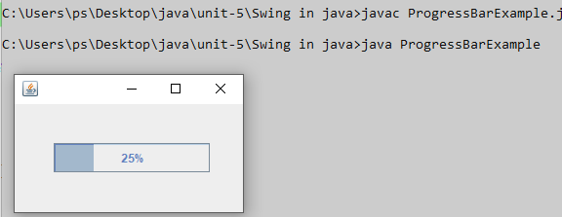
import javax.swing.*;
public class ProgressBarExample extends JFrame
{
JProgressBar jb;
int i=0,num=0;
ProgressBarExample()
{
jb=new JProgressBar(0,2000);
jb.setBounds(40,40,160,30);
jb.setValue(0);
jb.setStringPainted(true);
add(jb);
setSize(250,150);
setLayout(null);
}
public void iterate()
{
while(i<=2000)
{
jb.setValue(i);
i=i+20;
try
{
Thread.sleep(500);
}catch(Exception e)
{
}
}
}
public static void main(String[] args) {
ProgressBarExample m=new ProgressBarExample();
m.setVisible(true);
m.iterate();
}
}

Slide 30
JFileChooser
The object of JFileChooser class represents a dialog window from which the user can select file. It inherits JComponent class.
JFileChooser class declaration
public class JFileChooser extends JComponent implements Accessible
Constructor | Description
JFileChooser() | Constructs a JFileChooser pointing to the user's default directory.
JFileChooser(File currentDirectory) | Constructs a JFileChooser using the given File as the path.
JFileChooser(String currentDirectoryPath) | Constructs a JFileChooser using the given path.

Slide 31
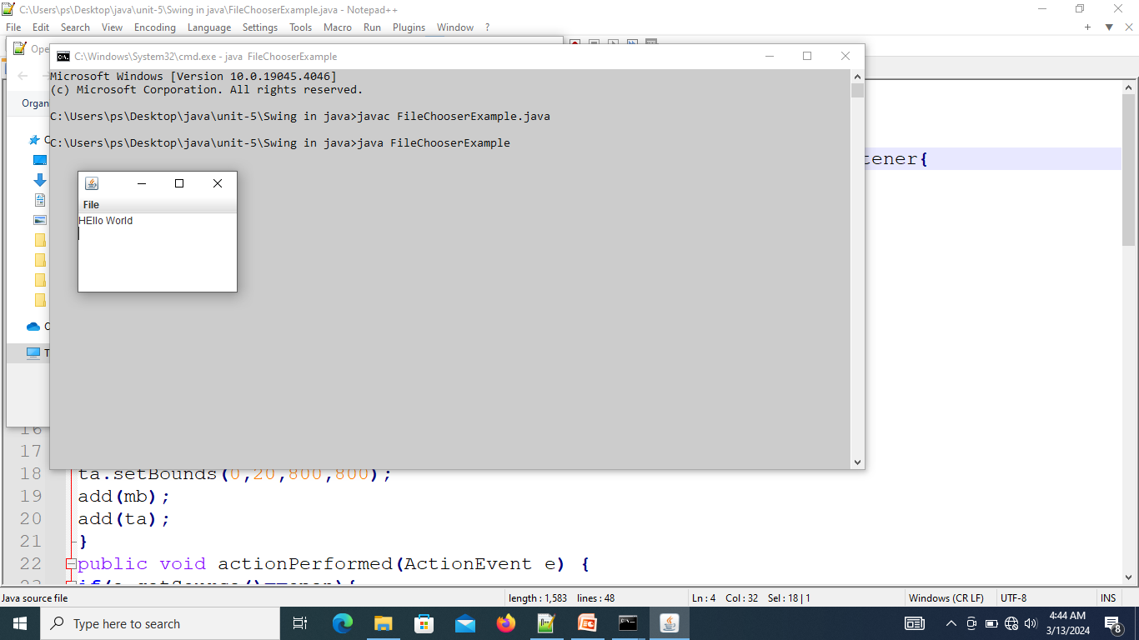
import javax.swing.*;
import java.awt.event.*;
import java.io.*;
public class FileChooserExample extends JFrame implements ActionListener{
JMenuBar mb; JMenu file; JMenuItem open; JTextArea ta;
FileChooserExample(){
open=new JMenuItem("Open File");
open.addActionListener(this);
file=new JMenu("File");
file.add(open);
mb=new JMenuBar();
mb.setBounds(0,0,800,20);
mb.add(file);
ta=new JTextArea(800,800);
ta.setBounds(0,20,800,800);
add(mb);
add(ta); }
public void actionPerformed(ActionEvent e) {
if(e.getSource()==open){
JFileChooser fc=new JFileChooser();
int i=fc.showOpenDialog(this);
if(i==JFileChooser.APPROVE_OPTION){
File f=fc.getSelectedFile();
String filepath=f.getPath();
try{
BufferedReader br=new BufferedReader(new FileReader(filepath));
String s1="",s2="";
while((s1=br.readLine())!=null){
s2+=s1+"\n";
}
ta.setText(s2);
br.close();
}catch (Exception ex) {ex.printStackTrace(); }
} } }
public static void main(String[] args) {
FileChooserExample om=new FileChooserExample();
om.setSize(500,500);
om.setLayout(null);
om.setVisible(true);
om.setDefaultCloseOperation(EXIT_ON_CLOSE);
} }

Slide 32
JTextField
JTextField is a part of javax.swing package.
The class JTextField is a component that allows editing of a single line of text.
JTextField class declaration :
public class JTextField extends JTextComponent implements SwingConstants

Slide 33
Constructor | Description
JTextField() | Creates a new TextField
JTextField(String text) | Creates a new TextField initialized with the specified text.
JTextField(String text, int columns) | Creates a new TextField initialized with the specified text and columns.
JTextField(int columns) | Creates a new empty TextField with the specified number of columns.

Slide 34
Methods | Description
void addActionListener(ActionListener l) | It is used to add the specified action listener to receive action events from this textfield.
Action getAction() | It returns the currently set Action for this ActionEvent source, or null if no Action is set.
void setFont(Font f) | It is used to set the current font.
void removeActionListener(ActionListener l) | It is used to remove the specified action listener so that it no longer receives action events from this textfield.

Slide 35
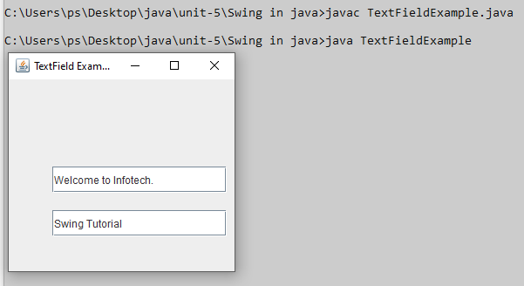
import javax.swing.*;
class TextFieldExample
{
public static void main(String args[])
{
JFrame f= new JFrame("TextField Example");
JTextField t1,t2;
t1=new JTextField("Welcome to Infotech.");
t1.setBounds(50,100, 200,30);
t2=new JTextField("Swing Tutorial");
t2.setBounds(50,150, 200,30);
f.add(t1); f.add(t2);
f.setSize(400,400);
f.setLayout(null);
f.setVisible(true);
}
}

Slide 36
JPasswordField
PasswordField is a part of javax.swing package .
The class JPasswordField is a component that allows editing of a single line of text where the view indicates that something was typed by does not show the actual characters.
JPasswordField inherits the JTextField class in javax.swing package.

Slide 37
Constructor | Description
JPasswordField() | Constructs a new JPasswordField, with a default document, null starting text string, and 0 column width.
JPasswordField(int columns) | Constructs a new empty JPasswordField with the specified number of columns.
JPasswordField(String text) | Constructs a new JPasswordField initialized with the specified text.
JPasswordField(String text, int columns) | Construct a new JPasswordField initialized with the specified text and columns.

Slide 38
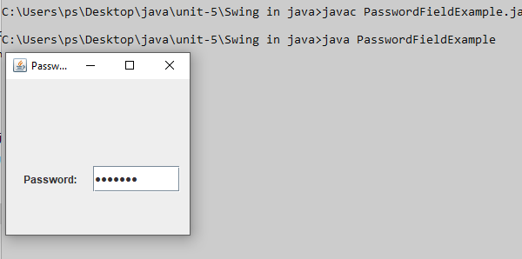
import javax.swing.*;
public class PasswordFieldExample {
public static void main(String[] args) {
JFrame f=new JFrame("Password Field Example");
JPasswordField value = new JPasswordField();
JLabel l1=new JLabel("Password:");
l1.setBounds(20,100, 80,30);
value.setBounds(100,100,100,30);
f.add(value); f.add(l1);
f.setSize(300,300);
f.setLayout(null);
f.setVisible(true);
}
}

Slide 39
JTextArea
The object of a JTextArea class is a multi line region that displays text.
It allows the editing of multiple line text.
It inherits JTextComponent class.
It is used to edit the text .
The text in JTextArea can be set to different available fonts and can be appended to new text .
A text area can be customized to the need of user .

Slide 40
Constructor | Description
JTextArea() | Creates a text area that displays no text initially.
JTextArea(String s) | Creates a text area that displays specified text initially.
JTextArea(int row, int column) | Creates a text area with the specified number of rows and columns that displays no text initially.
JTextArea(String s, int row, int column) | Creates a text area with the specified number of rows and columns that displays specified text.

Slide 41
append(String s) : appends the given string to the text of the text area.
getLineCount() : get number of lines in the text of text area.
setFont(Font f) : sets the font of text area to the given font.
setColumns(int c) : sets the number of columns of the text area to given integer.
setRows(int r) : sets the number of rows of the text area to given integer.
getColumns() : get the number of columns of text area.
getRows() : get the number of rows of text area.

Slide 42
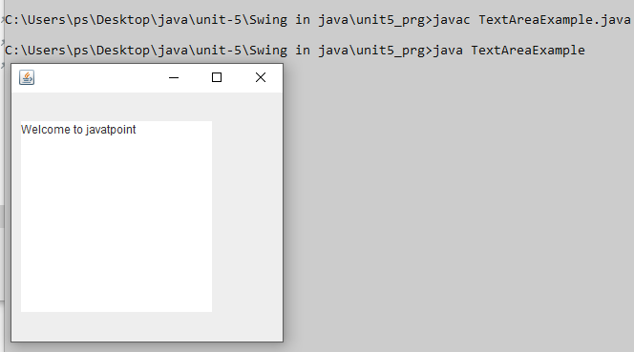
import javax.swing.*;
public class TextAreaExample
{
TextAreaExample(){
JFrame f= new JFrame();
JTextArea area=new JTextArea("Welcome to javatpoint");
area.setBounds(10,30, 200,200);
f.add(area);
f.setSize(300,300);
f.setLayout(null);
f.setVisible(true);
}
public static void main(String args[])
{
new TextAreaExample();
}}

Slide 43
JScrollBar
The object of JScrollbar class is used to add horizontal and vertical scrollbar. It is an implementation of a scrollbar. It inherits JComponent class.
JScrollBar class declaration
public class JScrollBar extends JComponent implements Adjustable, Accessible
Constructor | Description
JScrollBar() | Creates a vertical scrollbar with the initial values.
JScrollBar(int orientation) | Creates a scrollbar with the specified orientation and the initial values.
JScrollBar(int orientation, int value, int extent, int min, int max) | Creates a scrollbar with the specified orientation, value, extent, minimum, and maximum.

Slide 44
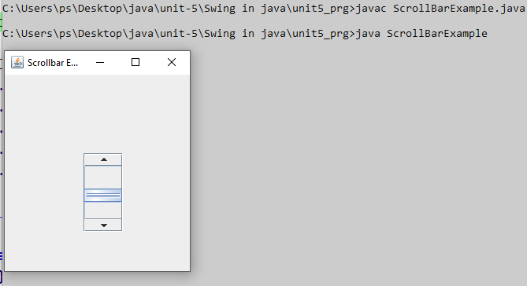
import javax.swing.*;
class ScrollBarExample
{
ScrollBarExample(){
JFrame f= new JFrame("Scrollbar Example");
JScrollBar s=new JScrollBar();
s.setBounds(100,100, 50,100);
f.add(s);
f.setSize(400,400);
f.setLayout(null);
f.setVisible(true);
}
public static void main(String args[])
{
new ScrollBarExample();
}}

Slide 45
JComboBox
JComboBox is a part of Java Swing package.
JComboBox inherits JComponent class .
JComboBox shows a popup menu that shows a list and the user can select a option from that specified list .
JComboBox can be editable or read- only depending on the choice of the programmer .

Slide 46
Constructor of the JComboBox are:
JComboBox() : creates a new empty JComboBox .
JComboBox(ComboBoxModel M) : creates a new JComboBox with items from specified ComboBoxModel
JComboBox(E [ ] i) : creates a new JComboBox with items from specified array.
JComboBox(Vector items) : creates a new JComboBox with items from the specified vector

Slide 47
Methods | Description
void addItem(Object anObject) | It is used to add an item to the item list.
void removeItem(Object anObject) | It is used to delete an item to the item list.
void removeAllItems() | It is used to remove all the items from the list.
void setEditable(boolean b) | It is used to determine whether the JComboBox is editable.
void addActionListener(ActionListener a) | It is used to add the ActionListener.
void addItemListener(ItemListener i) | It is used to add the ItemListener.

Slide 48
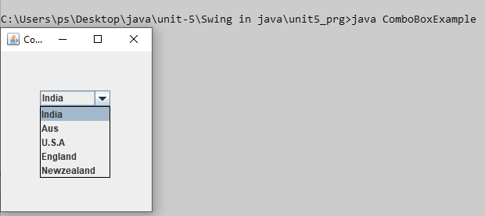
import javax.swing.*;
public class ComboBoxExample {
JFrame f;
ComboBoxExample(){
f=new JFrame("ComboBox Example");
String country[]={"India","Aus","U.S.A","England","Newzealand"};
JComboBox cb=new JComboBox(country);
cb.setBounds(50, 50,90,20);
f.add(cb);
f.setLayout(null);
f.setSize(400,500);
f.setVisible(true);
}
public static void main(String[] args) {
new ComboBoxExample();
}
}

Slide 49
JList
JList is a component that displays a set of Objects and allows the user to select one or more items .
JList inherits JComponent class. JList is a easy way to display an array of Vectors .
Constructor | Description
JList() | Creates a JList with an empty, read-only, model.
JList(ary[] listData) | Creates a JList that displays the elements in the specified array.
JList(ListModel<ary> dataModel) | Creates a JList that displays elements from the specified, non-null, model.

Slide 50
Methods | Description
Void addListSelectionListener(ListSelectionListener listener) | It is used to add a listener to the list, to be notified each time a change to the selection occurs.
int getSelectedIndex() | It is used to return the smallest selected cell index.
ListModel getModel() | It is used to return the data model that holds a list of items displayed by the JList component.
void setListData(Object[] listData) | It is used to create a read-only ListModel from an array of objects.

Slide 51
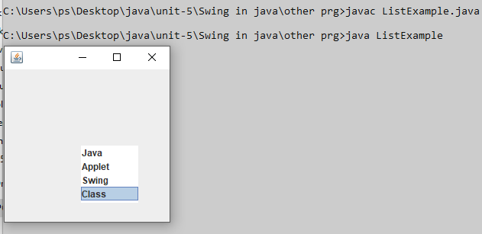
import javax.swing.*;
public class ListExample
{
ListExample(){
JFrame f= new JFrame();
DefaultListModel l1 = new DefaultListModel();
l1.addElement("Java");
l1.addElement("Applet");
l1.addElement("Swing");
l1.addElement("Class");
JList list = new JList(l1);
list.setBounds(100,100, 75,75);
f.add(list);
f.setSize(400,400);
f.setLayout(null);
f.setVisible(true);
}
public static void main(String args[])
{
new ListExample();
}}

Slide 52
Menus
JMenuBar, JMenu and JMenuItems are a part of Java Swing package. JMenuBar is an implementation of menu bar .
The JMenuBar contains one or more JMenu objects, when the JMenu objects are selected they display a popup showing one or more JMenuItems . JMenu basically represents a menu . It contains several JMenuItem Object . It may also contain JMenu Objects (or submenu).

Slide 53
Constructor
JMenuBar() : Creates a new MenuBar.
JMenu() : Creates a new Menu with no text.
JMenu(String name) : Creates a new Menu with a specified name.
JMenu(String name, boolean b) : Creates a new Menu with a specified name and boolean
Commonly used methods:
add(JMenu c) : Adds menu to the menu bar. Adds JMenu object to the Menu bar.
add(Component c) : Add component to the end of JMenu
add(Component c, int index) : Add component to the specified index of JMenu
add(JMenuItem menuItem) : Adds menu item to the end of the menu.
add(String s) : Creates a menu item with specified string and appends it to the end of menu.
getItem(int index) : Returns the specified menuitem at the given index

Slide 54
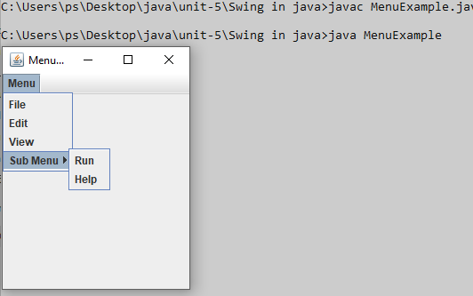
import javax.swing.*;
class MenuExample
{
JMenu menu, submenu;
JMenuItem i1, i2, i3, i4, i5;
MenuExample(){
JFrame f= new JFrame("Menu and MenuItem Example");
JMenuBar mb=new JMenuBar();
menu=new JMenu("Menu");
submenu=new JMenu("Sub Menu");
i1=new JMenuItem("File");
i2=new JMenuItem("Edit");
i3=new JMenuItem("View");
i4=new JMenuItem("Run");
i5=new JMenuItem("Help");
menu.add(i1); menu.add(i2); menu.add(i3);
submenu.add(i4); submenu.add(i5);
menu.add(submenu);
mb.add(menu);
f.setJMenuBar(mb);
f.setSize(400,400);
f.setLayout(null);
f.setVisible(true);
}
public static void main(String args[])
{
new MenuExample();
}}

Slide 55
Introduction to Event Handling
Changing the state of an object is known as an event. For example, click on button, dragging mouse etc. The java.awt.event package provides many event classes and Listener interfaces for event handling.
Classification of Events
Foreground Events
Background Events

Slide 56
1. Foreground Events
Foreground events are the events that require user interaction to generate, i.e., foreground events are generated due to interaction by the user on components in Graphic User Interface (GUI). Interactions are nothing but clicking on a button, scrolling the scroll bar, cursor moments, etc.
2. Background Events
Events that don’t require interactions of users to generate are known as background events. Examples of these events are operating system failures/interrupts, operation completion, etc.

Slide 57
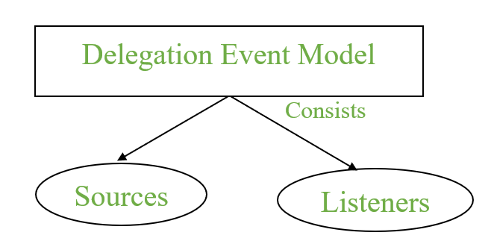
Delegation Event model
It has Sources and Listeners.

Slide 58
Source: Events are generated from the source. There are various sources like buttons, checkboxes, list, menu-item, choice, scrollbar, text components, windows, etc., to generate events.
Listeners: Listeners are used for handling the events generated from the source. Each of these listeners represents interfaces that are responsible for handling events.
To perform Event Handling, we need to register the source with the listener.
Registering the Source With Listener
Different Classes provide different registration methods.
Syntax: addTypeListener()
where Type represents the type of event.
Example 1: For KeyEvent we use addKeyListener() to register.
Example 2:that For ActionEvent we use addActionListener() to register.

Slide 59
Note: As Interfaces contains abstract methods which need to implemented by the registered class to handle events.
Event Class | Listener Interface | Description
ActionEvent | ActionListener | An event that indicates that a component-defined action occurred like a button click or selecting an item from the menu-item list.
AdjustmentEvent | AdjustmentListener | The adjustment event is emitted by an Adjustable object like Scrollbar.
ComponentEvent | ComponentListener | An event that indicates that a component moved, the size changed or changed its visibility.
ContainerEvent | ContainerListener | When a component is added to a container (or) removed from it, then this event is generated by a container object.
TextEvent | TextListener | An event that occurs when an object’s text changes.
WindowEvent | WindowListener | An event which indicates whether a window has changed its status or not.

Slide 60
FocusEvent | FocusListener | These are focus-related events, which include focus, focusin, focusout, and blur.
ItemEvent | ItemListener | An event that indicates whether an item was selected or not.
KeyEvent | KeyListener | An event that occurs due to a sequence of keypresses on the keyboard.
MouseEvent | MouseListener & MouseMotionListener | The events that occur due to the user interaction with the mouse (Pointing Device).
MouseWheelEvent | MouseWheelListener | An event that specifies that the mouse wheel was rotated in a component.

Slide 61
Different interfaces consists of different methods which are specified below.
Listener Interface | Methods
ActionListener | actionPerformed()
AdjustmentListener | adjustmentValueChanged()
ComponentListener | componentResized() componentShown() componentMoved() componentHidden()
ContainerListener | componentAdded() componentRemoved()
FocusListener | focusGained() focusLost()

Slide 62
ItemListener | itemStateChanged()
KeyListener | keyTyped() keyPressed() keyReleased()
MouseListener | mousePressed() mouseClicked() mouseEntered() mouseExited() mouseReleased()
MouseMotionListener | mouseMoved() mouseDragged()
MouseWheelListener | mouseWheelMoved()
TextListener | textChanged()
WindowListener | windowActivated() windowDeactivated() windowOpened() windowClosed() windowClosing() windowIconified() windowDeiconified()

Slide 63
Event Classes | Listener Interfaces
ActionEvent | ActionListener
MouseEvent | MouseListener and MouseMotionListener
MouseWheelEvent | MouseWheelListener
KeyEvent | KeyListener
ItemEvent | ItemListener
TextEvent | TextListener
AdjustmentEvent | AdjustmentListener
WindowEvent | WindowListener
ComponentEvent | ComponentListener
ContainerEvent | ContainerListener
FocusEvent | FocusListener

